Slide 1
BOOK STORE
Team Members:
Navya sri Rampally
Roshini
Tarun
Shiva kumar
Vaishanvi

Slide 2
OBJECTIVES
Project Understanding
Use Case Diagram For Book
Class Diagram
Sequence Diagram
Activity Diagram
Approach used
Customer module
Best Practices
Notes:
Add instructor notes here.

Slide 3
PROJECT UNDERSTANDING
Book store Management System is a web application to automate all kinds of operations in the book shop. The purpose of this software is to create customer, manage the books in the book store, manage the orders and also mange reviews and cart.

Slide 4
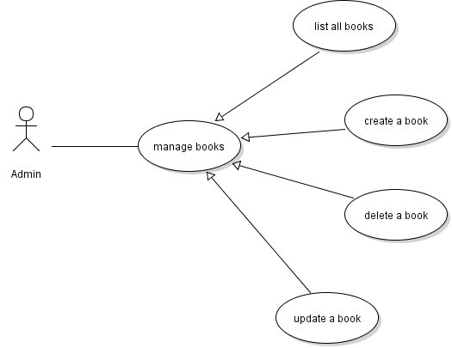
USE CASE DIAGRAM FOR CUSTOMER MANAGEMENT

Slide 5
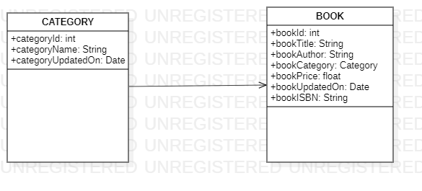
CLASS DIAGRAM

Slide 6
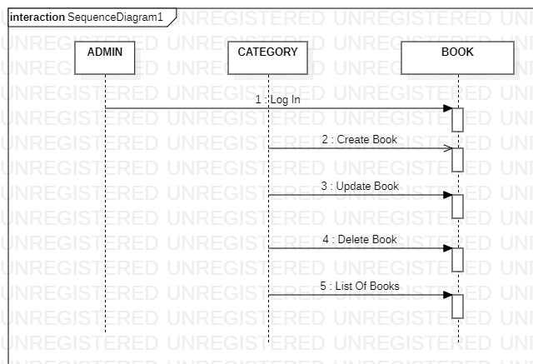
SEQUENCE DIAGRAM

Slide 7
ACTIVITY DIAGRAM
Login as admin with valid credentials
Click on
Create New Book
Click on
Delete Book
Click on
Edit Book
Click on save
Click on delete
Click on save
Log out

Slide 8
APPROACH USED
    Front End & Web Components:–
      Angular 8
    Business Logic Components :-
      -Spring Boot
    Databases:-
      -Oracle SQL

Slide 9
CUSTOMER MODULE
View List of Books
Add Book
Update Book
Delete Book

Slide 10
BEST PRACTICES
Followed placing comments in appropriate places
Followed naming conventions.
Followed proper indentation.

Slide 11


